Slide 1
Deuteronomy 7 is relevant for us today because it teaches Principles that determine
the success of our Christian walk
In encouraging the people to do what is right – Moses addresses the following
significant 9 issues
1) Don’t forget God (the real God not the idol we sometimes make)
2) Care for the Disadvantaged
3) No generation stands alone Moses interprets the past for the sake of the future

Slide 2
4) Obedience is Essential to success in the Christian Journey ( ** just say Yes)
5) To hear x 50 To do, to keep, to observe x 177
6) Personal Responsibility for Obedience To God Must be Accepted *
7) Be Open to the Future Egypt, Wilderness and P/L God is with them
8) God Acts among His people ( we can get used to “ doing “ without His help)
9) The Covenant between God and the people must be renewed ( He is King ) *

Slide 3
This chapter teaches that the Israelites where
Separated to God Chapter 7 : 1 - 5
Selected by God Chapter 7: 6 – 11
Successful in God Chapter 7 : 12 - 26

Slide 4
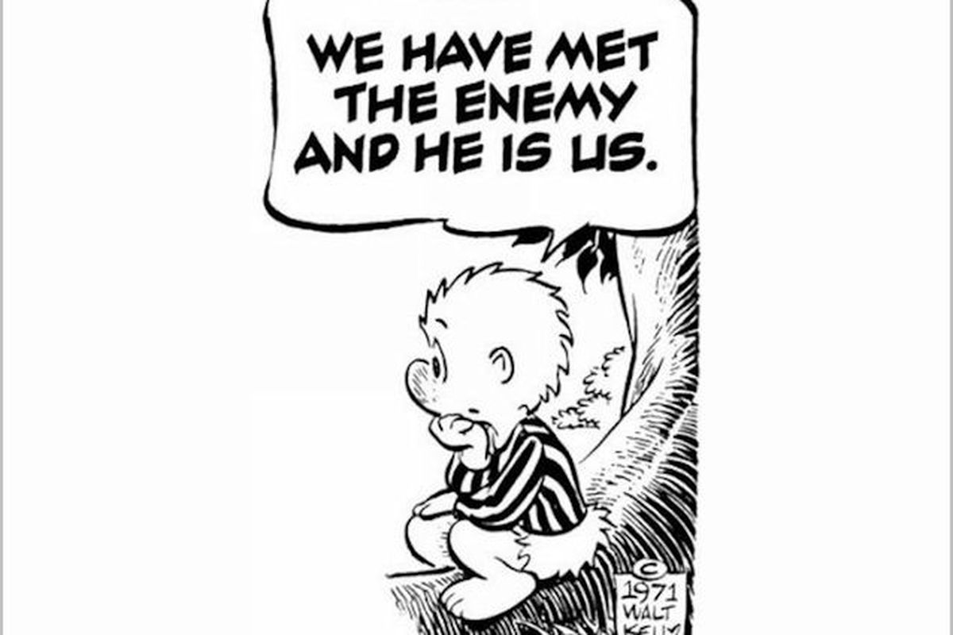
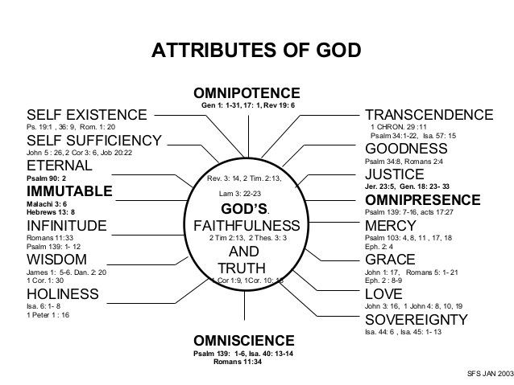
Because the story we tell of our lives is not so much about us, as about Him
What do I see ?

